Slide 1
APNET 2025
Cost-Efficient and Reliable SFC Orchestration in Mobile Edge Computing
Yuanfei Xiao, Zhenli He, Qixin Peng
Yunnan University
APNET 2025, Shanghai
Notes:
Good afternoon everyone. I’m Yuanfei from Yunnan University. Today, I’m honored to present our work titled “Cost-Efficient and Reliable SFC Orchestration in Mobile Edge Computing”

Slide 2
Background & Motivation
Problem & Key Challenges
System Model & Formulation
A2C-SFC Framework Overview
Evaluation
Conclusion and Furture Work
Notes:
Next, I will introduce our work in the following six chapters.

Slide 3
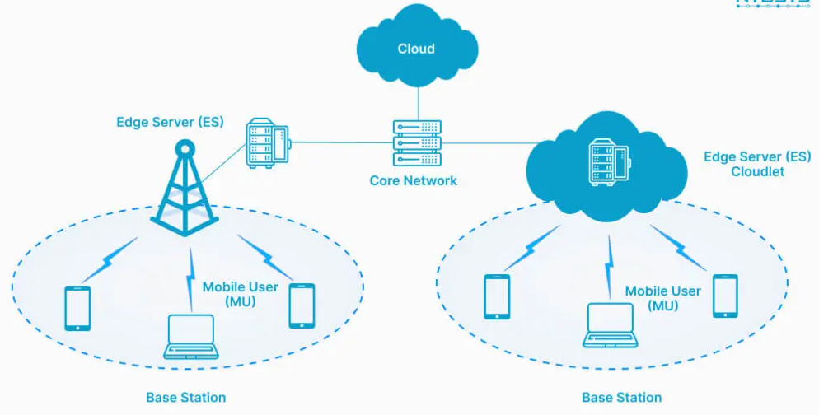
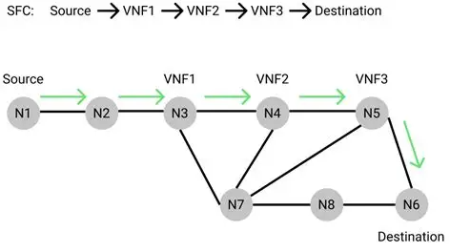
1
Background & Motivation
The convergence of NFV and MEC enables flexible, low-latency network services
SFCs are key enablers of such services in smart city, industrial IoT
However, SFC orchestration must simultaneously meet latency, reliability, and cost-efficiency constraints
Notes:
the first is Background & Motivation
The convergence of network function virtualization (NFV) and mobile edge computing (MEC) enables flexible, low-latency service delivery in applications like smart cities and industrial internet of things (IoT).
To enable such services, Service Function Chains (SFCs) are deployed to process data through a sequence of Virtual Network Functions.
However, orchestrating SFCs in edge environments is particularly challenging — we need to simultaneously optimize latency, reliability, and cost, which often conflict with each other.

Slide 4
2
Problem & Key Challenges
Core Problem: In MEC, SFC orchestration requires joint optimization of latency, reliability, and cost. But:
The objectives are tightly coupled — independent optimization is ineffective
Existing policies are static and inflexible in dynamic environments
A unified, scalable framework is lacking for joint orchestration
Latency | Reliability | Cost
VNFs distributed across nodes | Single point failures disrupt entire chains | Redundancy and low-latency paths are costly
Existing methods typically optimize only a single objective or a subset of goals, neglecting the full trade-offs and interdependencies among all three.
Notes:
Let me summarize the core problem.
In MEC, SFC orchestration requires joint optimization of latency, reliability, and cost. But:
• These objectives are tightly coupled — optimizing them independently leads to suboptimal solutions.
• Existing policies are mostly static and inflexible, unable to adapt to dynamic workloads.
• A unified and scalable framework is still lacking.
Existing methods typically optimize only a single objective or a subset of goals, neglecting the full trade-offs and interdependencies among all three.

Slide 5
3
System Model & Formulation
1.Network Model: The infrastructure is modeled as an undirected graph G = (N, L), where:
N represents edge servers, each with computing capacity, memory, failure rate, and cost
L represents communication links with associated bandwidth and propagation latency
2.SFC Request Model: Each SFC is a sequence of Virtual Network Functions (VNFs) with:
End-to-end delay constraint
Minimum service reliability threshold
Specific CPU and memory requirements per VNF
3. Delay Modeling: End-to-end latency includes:
Transmission delay over links
Propagation delay between nodes
Computation delay at VNF-hosting nodes
Initialization delay for VNF instantiation
Notes:
to solve these key challenges, we first inroduce our system model and formulate the optimization problem.
Our system model is as follows:
• The MEC infrastructure is modeled as an undirected graph G = (N, L). Each node represents an edge server with limited memory, CPU, failure rate, and cost and each link with associated bandwidth and propagation latency and cost
• Each SFC is a sequence of VNFs, with constraints on delay, reliability, and resource demand.
• End-to-end delay consists of transmission, propagation, computation, and initialization latency.

Slide 6
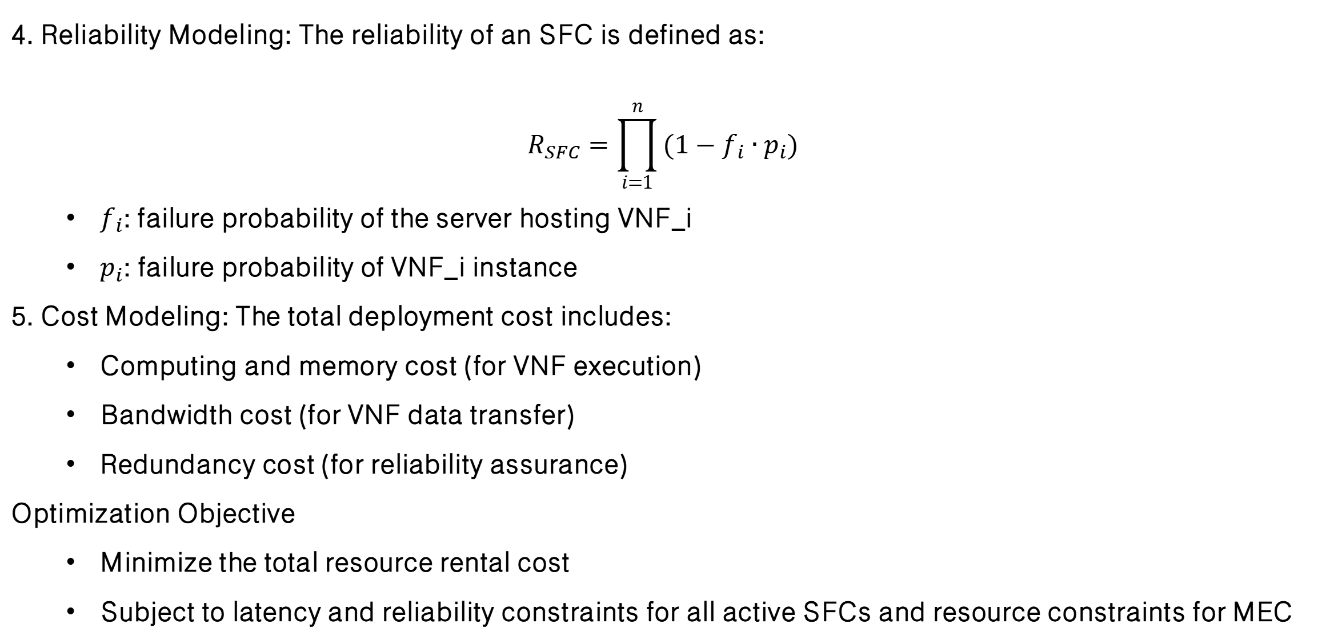
3
System Model & Formulation
4. Reliability Modeling: The reliability of an SFC is defined as:
$$R_{SFC}=\prod_{i=1}^{n}{(1−f_{i}∙p_{i})}$$
$f_{i}$: failure probability of the server hosting VNF_i
$p_{i}$: failure probability of VNF_i instance
5. Cost Modeling: The total deployment cost includes:
Computing and memory cost (for VNF execution)
Bandwidth cost (for VNF data transfer)
Redundancy cost (for reliability assurance)
Optimization Objective
Minimize the total resource rental cost
Subject to latency and reliability constraints for all active SFCs and resource constraints for MEC
Notes:
the SFC reliability is composed of physical node reliability and VNF reliability.
The total deployment cost consists of three parts:
Computing and memory cost (for VNF execution)
Bandwidth cost (for VNF data transfer)
Redundancy cost (for reliability assurance)
• Our optimization goal is to minimize the total cost, while satisfying delay and reliability constraints.

Slide 7
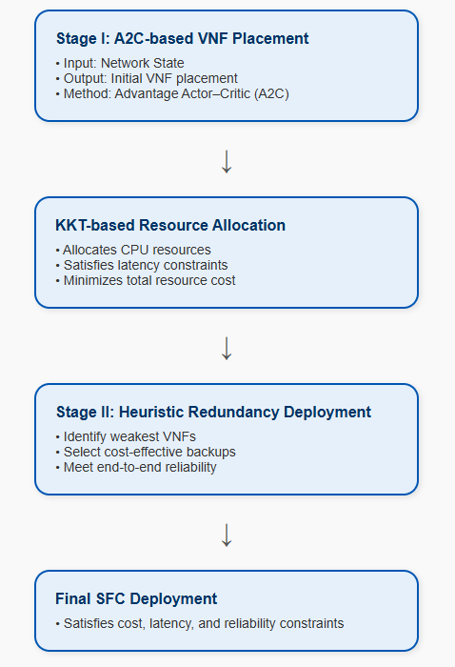
4
A2C-SFC Framework Overview
Stage I: Uses an Advantage Actor–Critic (A2C) agent to determine the placement of VNFs. Then applies KKT optimization to allocate CPU resources while satisfying end-to-end delay constraints.
Stage II: A lightweight heuristic algorithm selects redundant VNF instances on disjoint servers to meet reliability requirements with minimal extra cost.
Notes:
To solve this, we propose A2C-SFC, a two-stage DRL framework:
• Stage I: We use an Advantage Actor–Critic (A2C) agent to place VNFs across edge nodes, and then solve a KKT-based resource allocation problem to distribute CPU.
• Stage II: We apply a lightweight heuristic algorithm to deploy redundant VNFs on disjoint nodes, in order to satisfy reliability constraints at minimal cost.

Slide 8
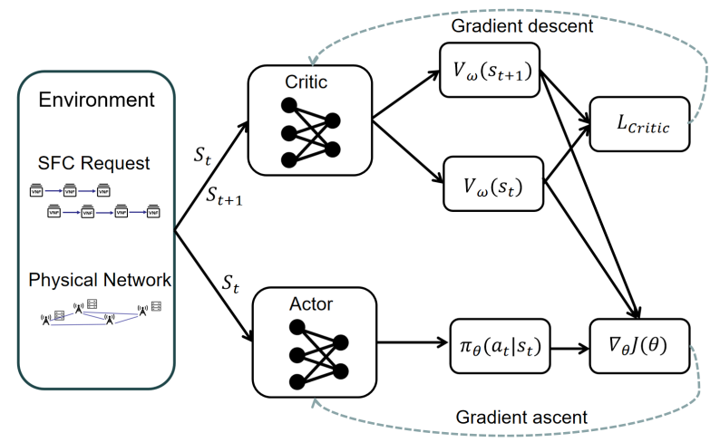
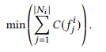
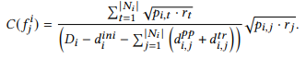
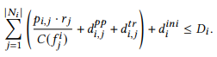
4
Stage I – VNF Placement and Resource Allocation
Markov Decision Process (MDP) Definition
State: Current SFC requests, MEC environment
Action: Placement decision: Assign each VNF_i to Node_j
Reward: Negative cost
KKT-Based CPU Allocation (after placement)
Given VNF-node assignment, we solve:
s.t.
Notes:
Stage I SFC placement problem is formulated as a Markov Decision Process:
• State includes the current SFC requests and MEC environment
• Action is the decision to location of each VNF.
• Reward is the negative cost.
After placement, we use KKT conditions to solve for the optimal CPU allocation, minimizing compute cost under delay bounds.

Slide 9
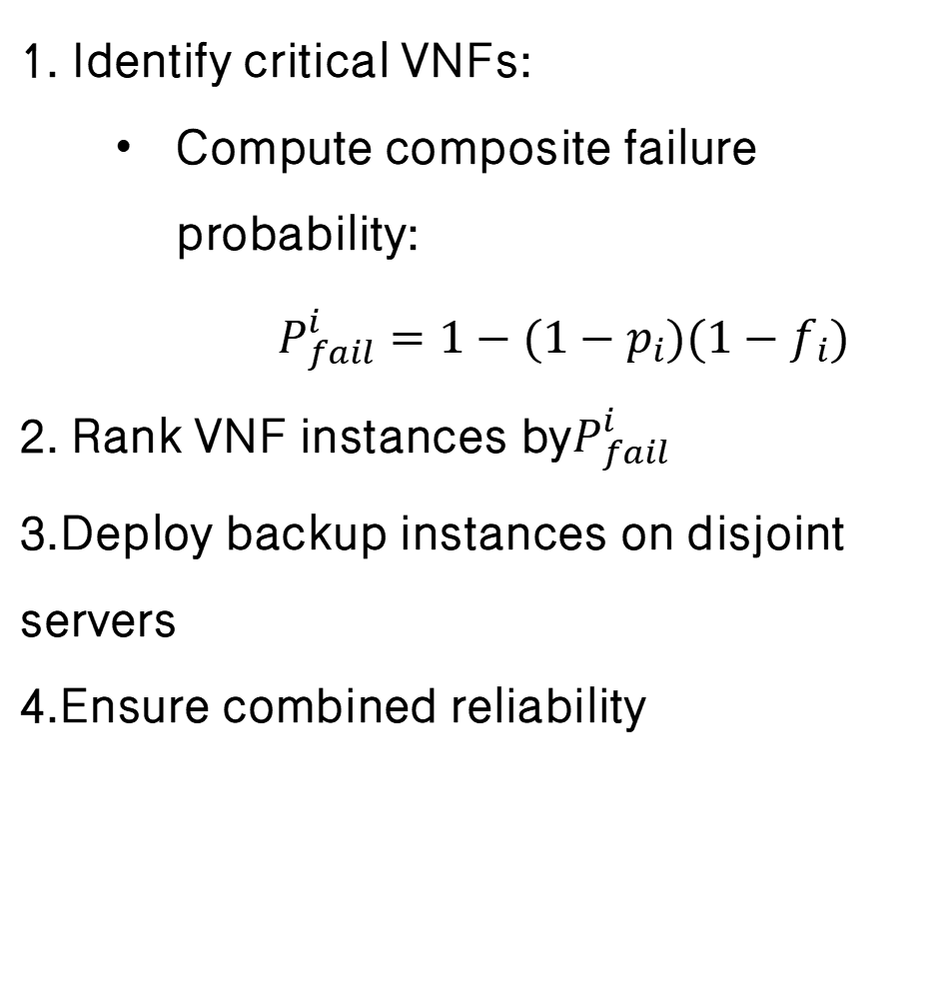
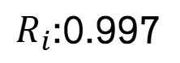
4
Stage II – Reliability-aware Redundancy
VNF1
VNF1
VNF1
VNF1
$R_{i}$:0.997
1. Identify critical VNFs:
Compute composite failure probability:
$$P_{fail}^{i}=1−(1−p_{i})(1−f_{i})$$
2. Rank VNF instances by$P_{fail}^{i}$
3.Deploy backup instances on disjoint servers
4.Ensure combined reliability
SFC Request:
Redundant List:
1
1
1
1
Rel=0.965
1
1
2
1
Rel=0.981
2
1
2
1
Rel=0.993
2
2
2
1
Rel=0.998
Notes:
In Stage II, we identify the most vulnerable VNFs based on both node and function failure probabilities.
We then deploy backup instances on appropriate physical node.
The core is to continuously select VNFs for backup and choose appropriate placement locations for redundant VNFs until SFC reliability meets requirements.

Slide 10
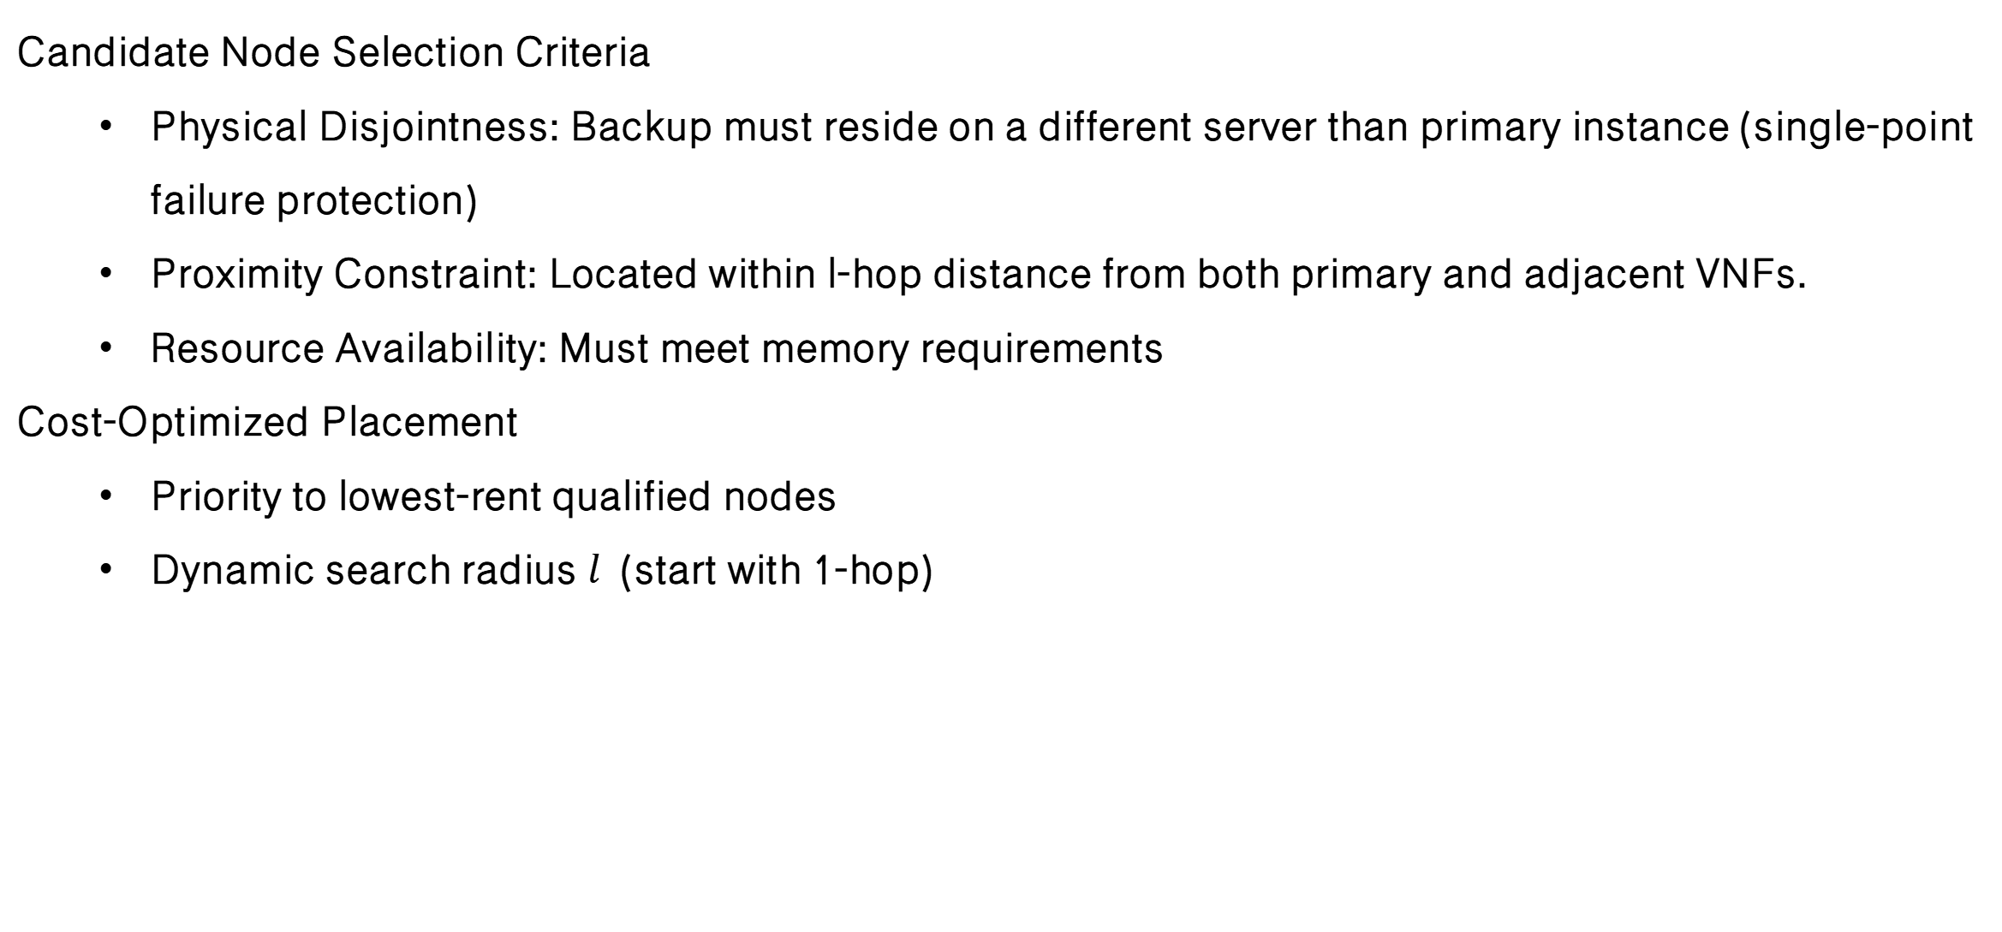
4
Stage II – Reliability-aware Redundancy
Candidate Node Selection Criteria
Physical Disjointness: Backup must reside on a different server than primary instance (single-point failure protection)
Proximity Constraint: Located within l-hop distance from both primary and adjacent VNFs.
Resource Availability: Must meet memory requirements
Cost-Optimized Placement
Priority to lowest-rent qualified nodes
Dynamic search radius $l$ (start with 1-hop)​
Notes:
When choosing where to place the backup VNF, we consider the following factors.
we pick the lowest-cost options, starting with nearby nodes and expanding only when necessary
This strategy ensures that the overall SFC reliability exceeds a given threshold, while minimizing the redundancy overhead.

Slide 11
5
Simulation Setup
Physical Network Configuration
20-node undirected graph, with 30% link probability
SFC & VNF Setup
15 VNF types with diverse delay/resource profiles
Each SFC: 3–6 VNFs, randomly selected
SFCs arrive stochastically over time
Baseline Algorithms Compared
Method | Type | Description
GA | Meta-heuristic | Evolves placements using crossover/mutation
PSO | Meta-heuristic | Particle swarm-based global search
PPO | DRL | Policy gradient with constrained updates
Greedy | Heuristic | Step-by-step cost-based node selection
Notes:
in evaluation stage, We simulate a 20-node physical network where each link has a 30% probability.
There are 15 VNF types, and each SFC consists of 3–6 VNFs.
We compare A2C-SFC with GA, PSO, PPO, and Greedy algorithms, across metrics like cost, initialization time, and execution time.

Slide 12
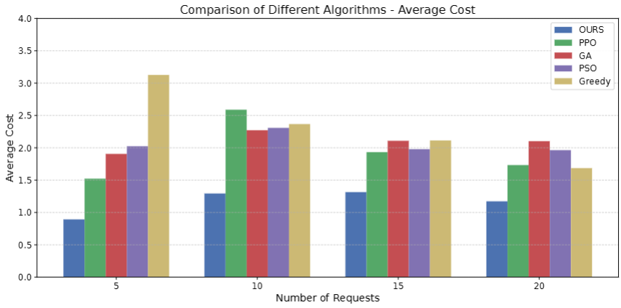
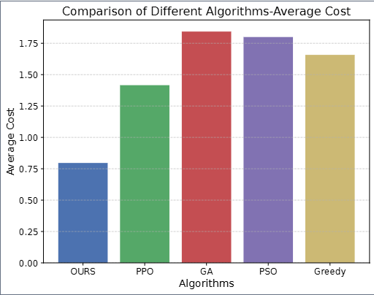
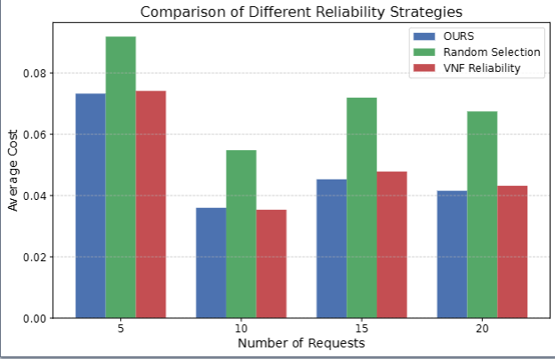
5
Experimental Results
Deterministic Load: a fixed number of SFC requests of 5, 10, 15, and 20 per time slot
Dynamic Load: a fluctuating number of SFC requests between 10 and 20 per time slot
Different redundancy deployment strategies
Notes:
The following are cost comparisons for a fixed number of SFC requests of 5, 10, 15, and 20 per time slot, a fluctuating number of SFC requests between 10 and 20, and a cost comparison of different reliability deployment strategies.
It proves that each stage of our two-stage algorithm has a good effect in reducing cost expenditure

Slide 13
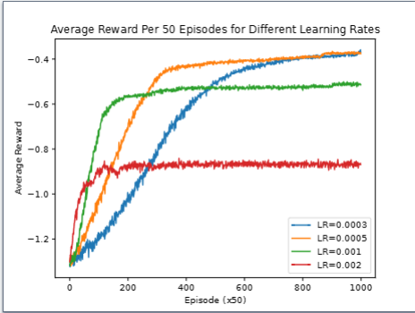
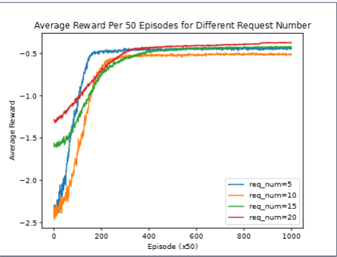
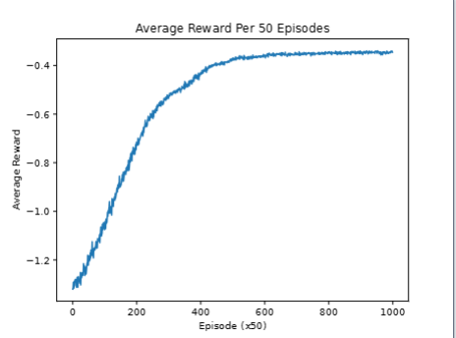
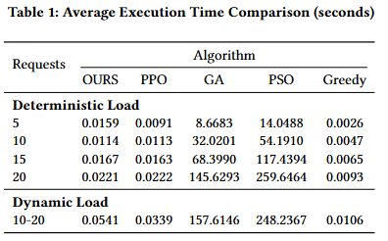
5
Experimental Results
Convergence performance analysis and execution time comparison
Notes:
Next, we show the convergence performance and execution time comparison of our algorithm.
Experimental results show that our algorithm has good robustness and can achieve millisecond-level decision-making

Slide 14
6
Conclusion &Future Work
Conclusion:
We proposed A2C-SFC, a two-stage deep reinforcement learning framework for joint VNF placement and redundancy management in MEC-based SFC orchestration.
Our approach integrates:
A2C for latency-aware placement,
KKT-based CPU allocation,
A heuristic redundancy strategy for reliability.
Extensive simulations show significant reductions in cost and delay, while satisfying reliability constraints under both static and dynamic service demands.
Future Work:
Extend the model to incorporate dynamic VNF workload prediction and adaptive scaling strategies.
Integrate reactive fault recovery mechanisms, enabling faster recovery from runtime failures.
Explore deployment in real-world MEC testbeds, evaluating practicality and scalability in production environments.
Notes:
To summarize:
• We propose A2C-SFC, a scalable two-stage DRL framework for cost-efficient and reliable SFC orchestration in MEC.
• Our method integrates A2C placement, KKT-based CPU allocation, and heuristic redundancy.
• Experiments show significant improvements in cost, delay, and reliability under dynamic traffic.
In future work, we plan to:
• Add VNF workload prediction and scaling strategies,
• Support reactive fault recovery, and
• Validate our method in real-world MEC deployments.

Slide 15
APNET 2025
Thanks!
Thank you! I’m happy to take questions now.
Notes:
Thank you for listening! I'm happy to take questions.

